Slide 1
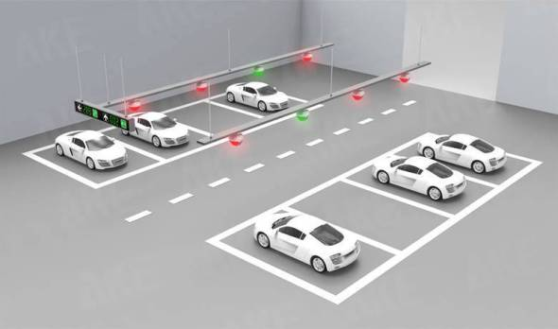
SMART PARKING SYSTEM

Slide 2
Smart parking is an IoT (Internet of Things) solution that uses sensors ,LCD screen front of the area it show how many slots are availabe ,and empty or cameras in combination with a software to inform users of vacant parking spaces in a certain area. Most of the time, people can also directly reserve the spot .

Slide 3
IR
sensor 1
IR sensor 2
LCD
IR sensor 3
ARDUINO
SERVO MOTOR
IR sensor 4
IR sensor 5
POWER SUPPLY
IR sensor 6

Slide 4
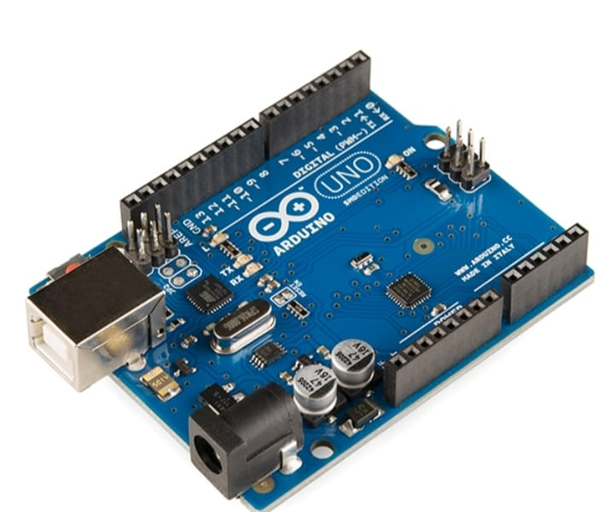
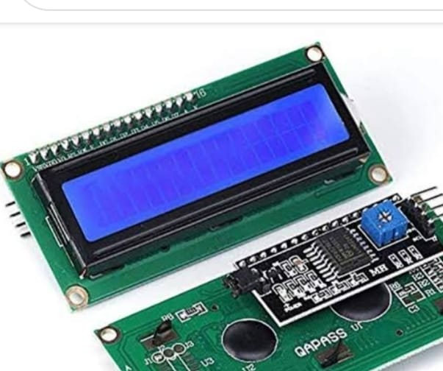
Arduino – Uno
The servo motors, LCD display, and IR sensor are all connected to an Arduino Uno microcontroller unit. The LCD shows how much space is available, and the IR sensors keep track of how many automobiles enter and exit the parking place. The IR sensors identify whether or not a parking place is available.
I2C LCD Display
The LCD shows how much space is available, and the IR sensors keep track of how many automobiles enter and exit the parking place. The IR sensors identify whether or not a parking place is available.

Slide 5
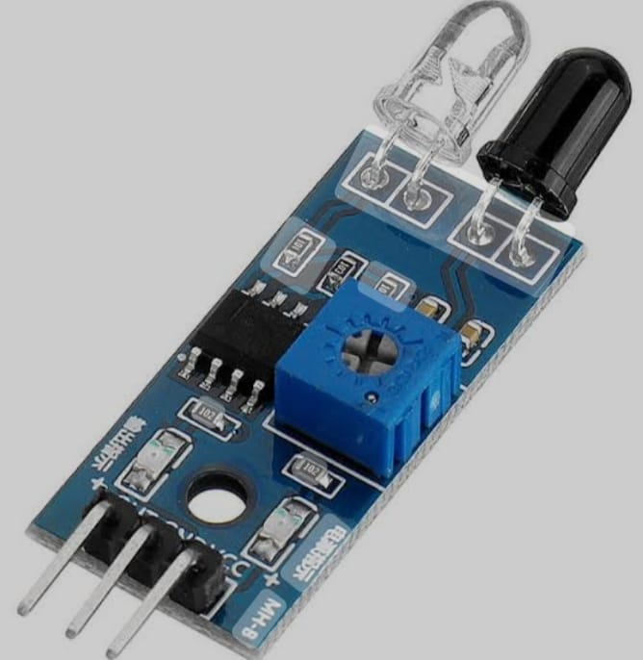
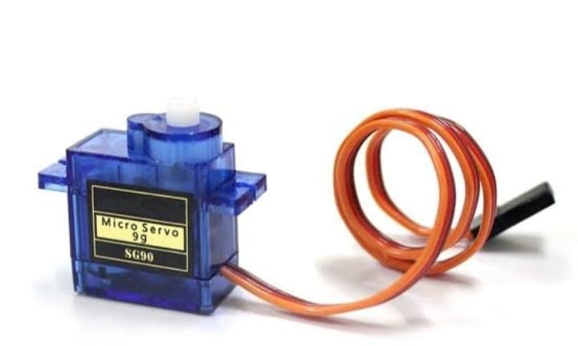
IR Sensor
When the IR sensor detects the presence of a car, the servo motor operates as a gate at the entrance, opening and closing. The parking places that are available for car drivers are displayed on the LCD. The presence is detected by the infrared sensors.
Servomotor
Upon the arrival of a vehicle, the entrance sensor will send out a signal, then the gate servo motor will raise the toll bar 90° from the resting position. This allows the awaiting car to enter the parking structure.

Slide 6
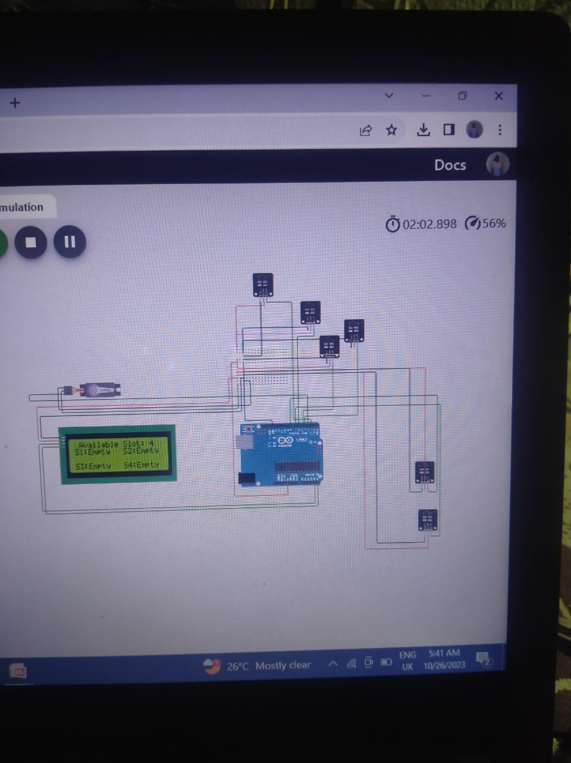
SIMULATION
IN WOKWI

Slide 7
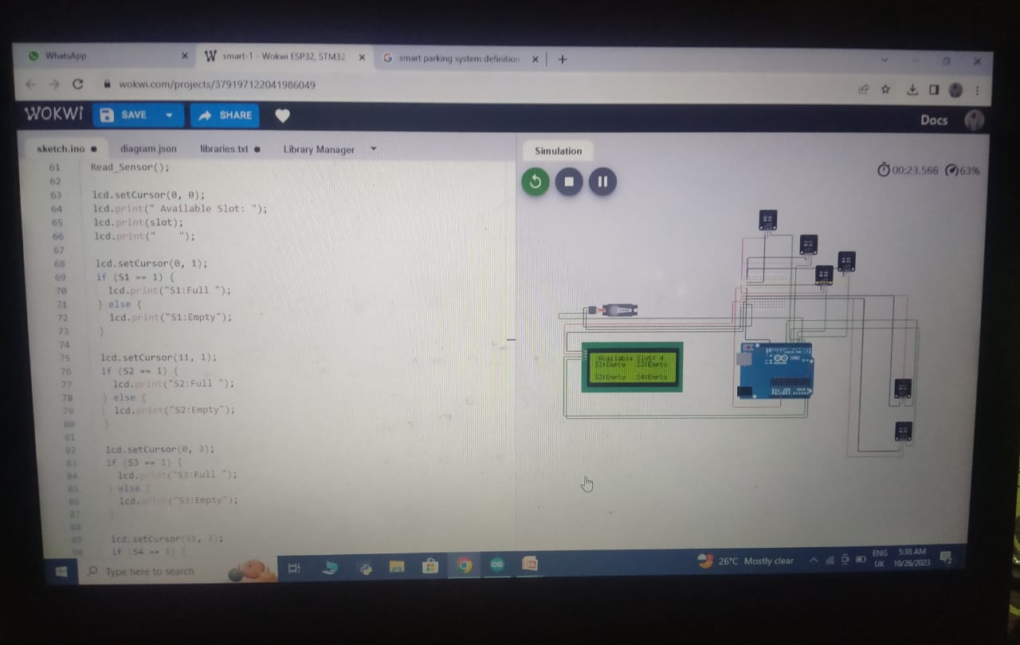

Slide 8
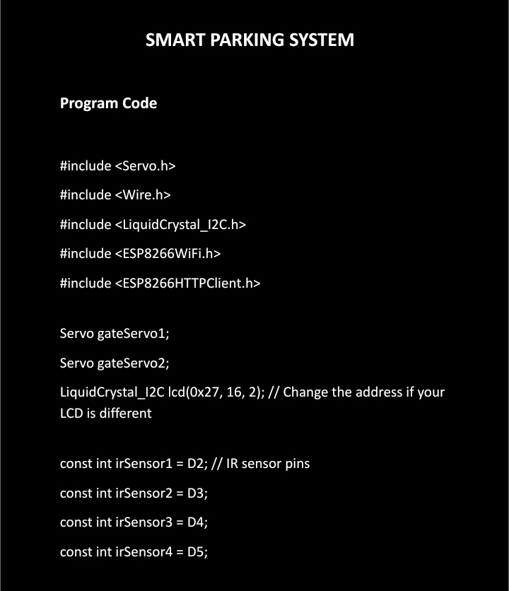
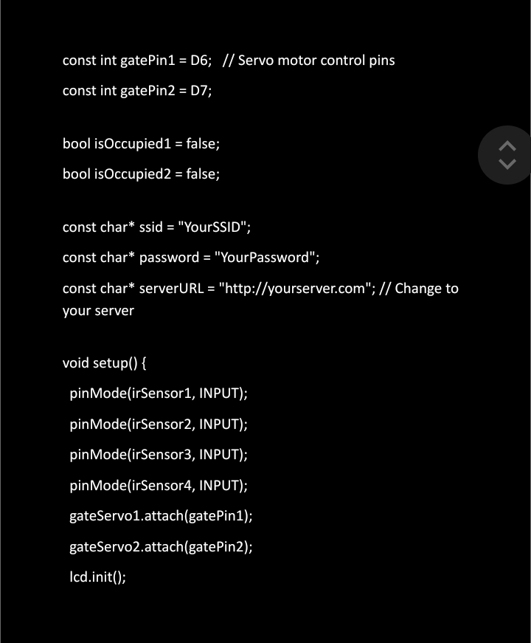

Slide 9
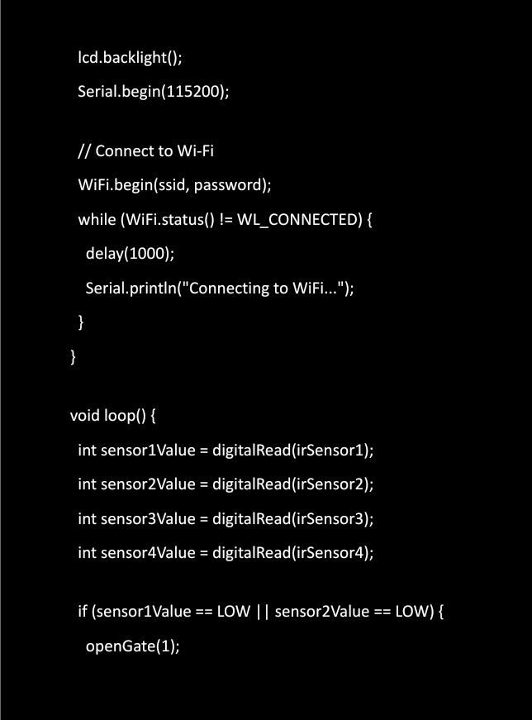
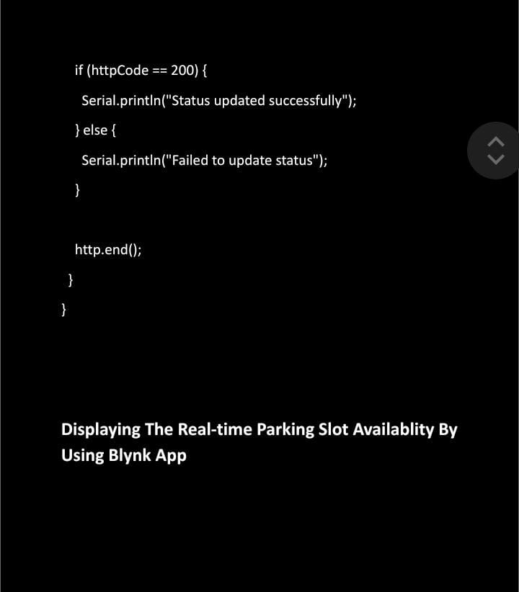

Slide 10
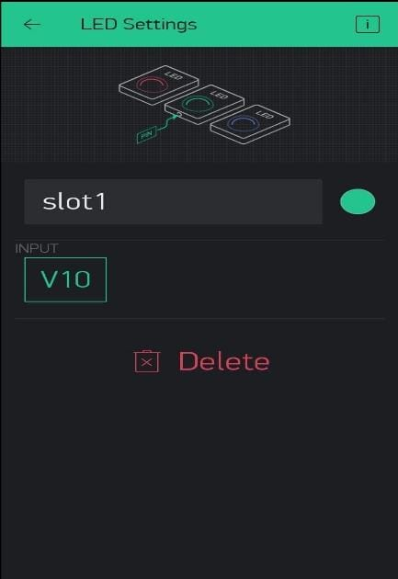
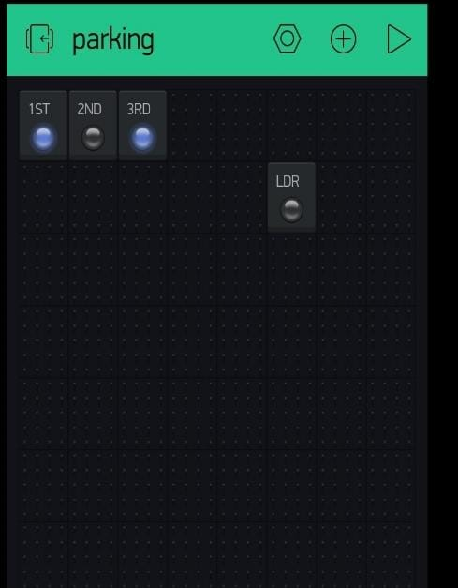
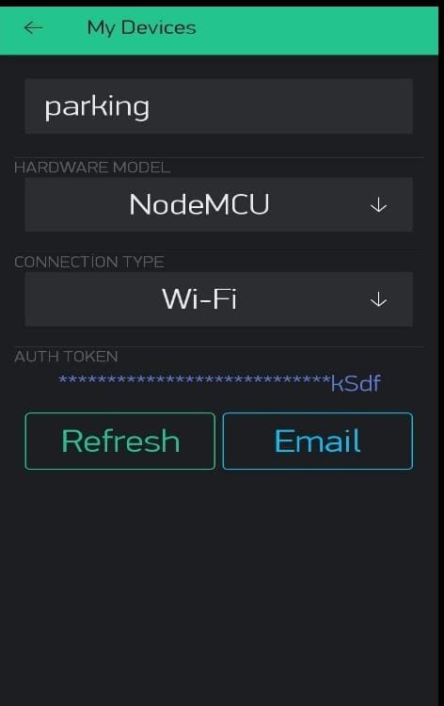
Externaly we are using nodeMCU to make a iot based.

Slide 11
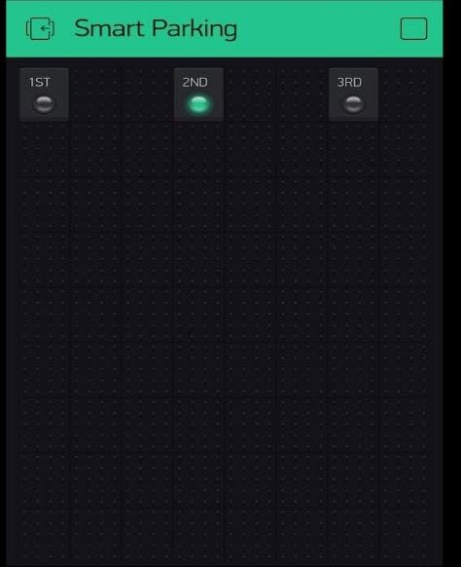
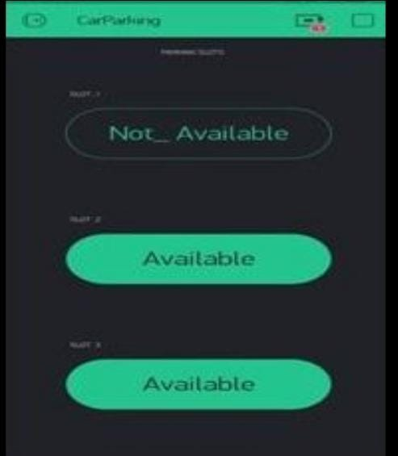

Slide 12
Conclusion:
IoT has many different applications, but one of the most exciting is its use in smart parking. IoT-based parking systems are able to better track the availability of parking spots on a given lot, making it easier to find an available parking spot.
Thank you

